Slide 1

Introduction to Data Science
Dr. Bhakti Palkar

Slide 2
Content
1. What is Data Science? Importance and applications of Data Science, Data Science workflow, The 5 V's of Data Science
2. Structured, semi-structured, and unstructured data. Challenges and considerations for handling different data types. Ethical Considerations in Data Science.

Slide 3



Data All Around
Lots of data is being collected and warehoused
Web data, e-commerce
Financial transactions, bank/credit transactions
Online trading and purchasing
Social Network
Google processes 20 PB a day (2008)
Facebook has 60 TB of daily logs

Slide 4
How much data is Big Data?
Google processes 20 Petabytes(PB) per day (2008)
Facebook has 2.5 PB of user data + 15 TB per day (2009)
eBay has 6.5 PB of user data + 50 TB per day (2009)
CERN’s Large Hadron Collider(LHC) generates 15 PB a year

Slide 5
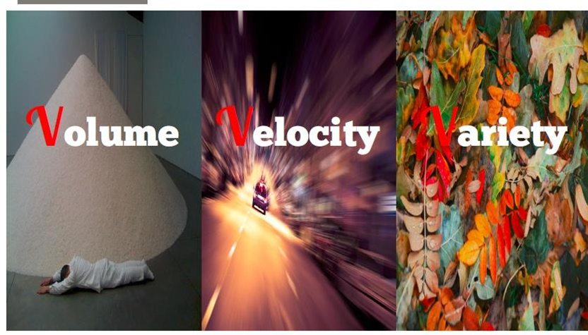
Big Data
Big Data is any data that is expensive to manage and hard to extract value from
Volume-The size of the data, Big data tools use Distributed systems
Velocity-The latency of data processing relative to the growing demand for interactivity, Eg. Social media messages going viral in seconds
Variety-the diversity of sources, formats, quality, structures. 80% of world data is unstructured.
So extremely large data sets may be analyzed computationally to reveal patterns, trends, and associations that are not transparent or easy to identify.

Slide 6



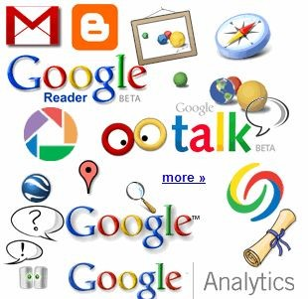

30 billion RFID tags today
(1.3B in 2005)
Volume
4.6
billion camera phones world wide
12+ TBs
of tweet data every day
100s of millions of
GPS
enabled
devices
sold annually
? TBs of data every day
25+ TBs of log data every day
76 million smart meters in 2009… 200M by 2014
2+
billion people on the Web by end 2011

Slide 7
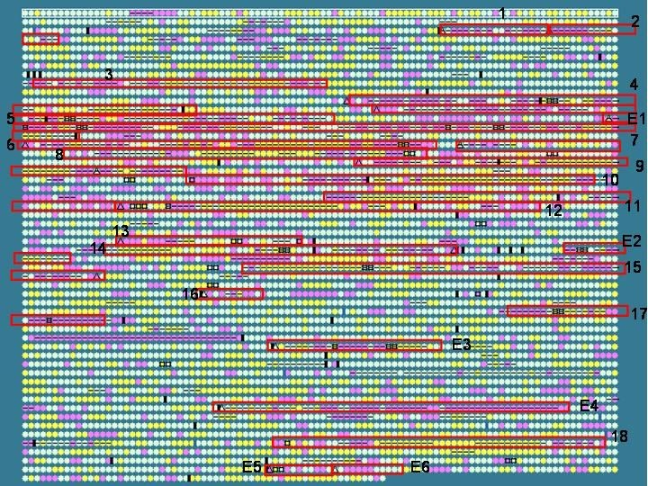
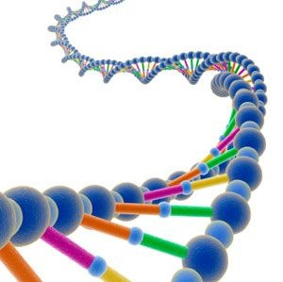
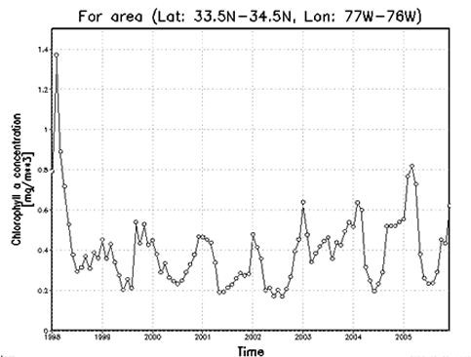
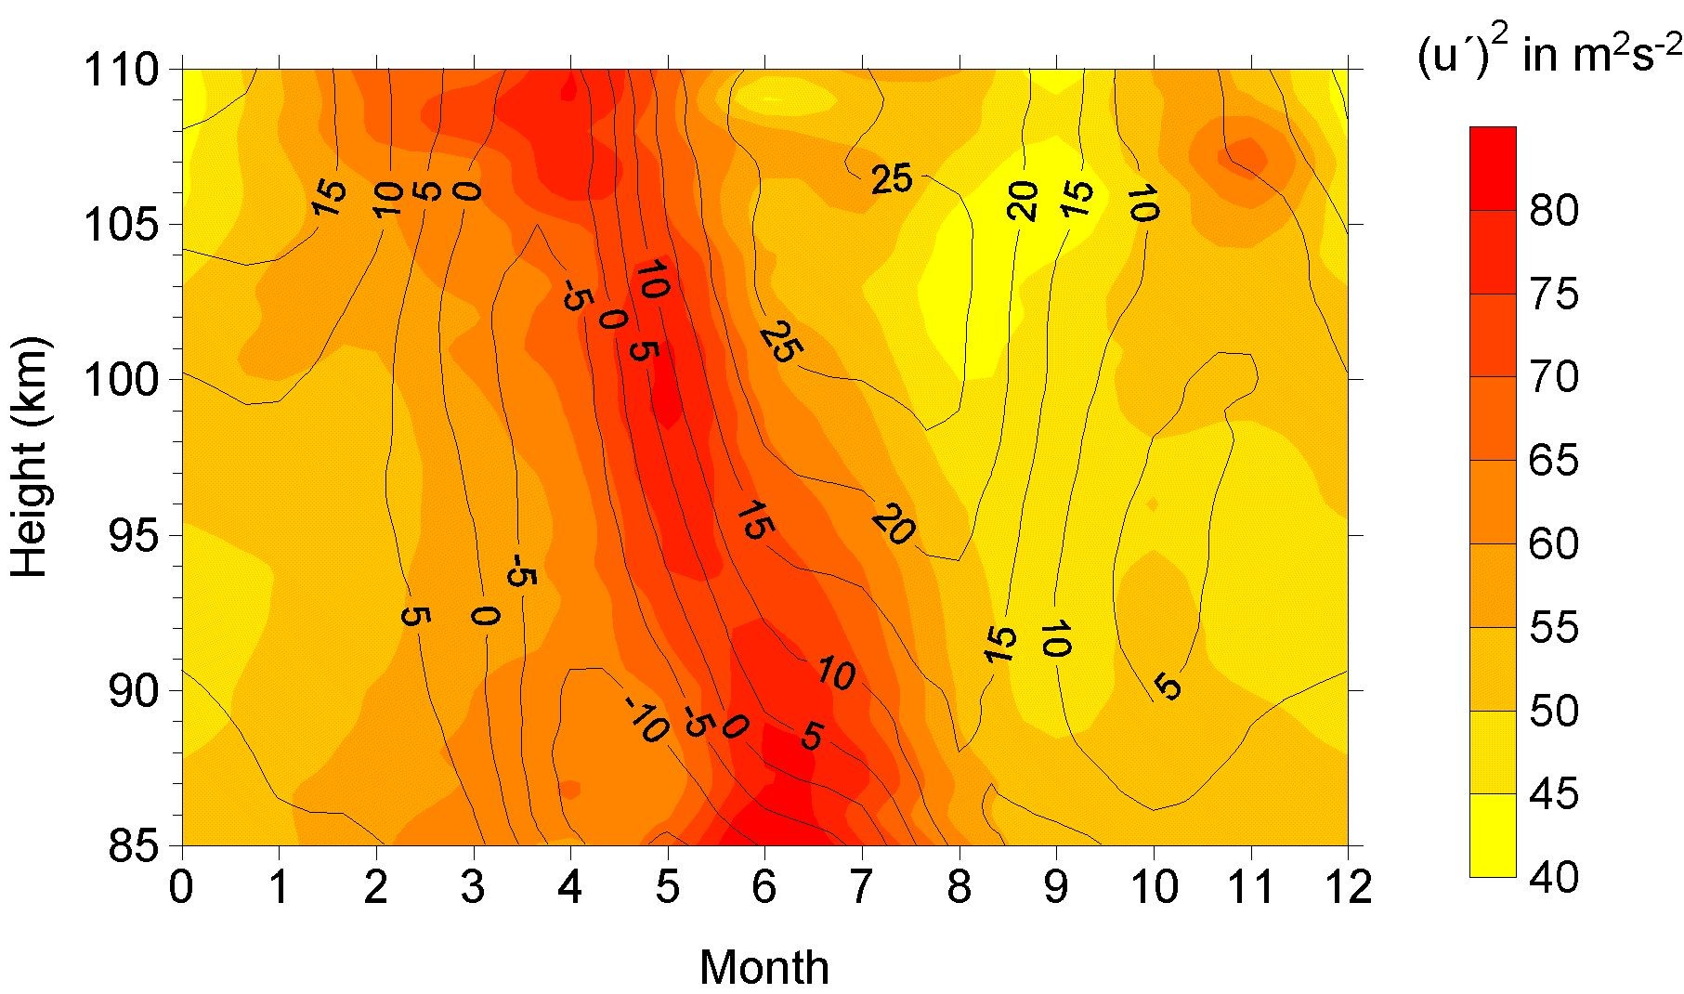
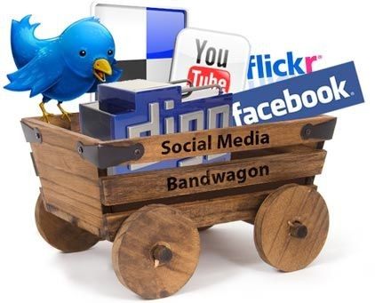
Variety
Relational Data (Tables/Transaction/Legacy Data)
Text Data (Web)
Semi-structured Data (XML)
Graph Data
Social Network, Semantic Web (RDF), …
Streaming Data
You can only scan the data once
A single application can be generating/collecting many types of data
Big Public Data (online, weather, finance, etc)

Slide 8

Velocity
Data is beging generated fast and need to be processed fast
Late decisions - missing opportunities
Examples
E-Promotions: Based on your current location, your purchase what you like , send promotions right now for store next to you
Healthcare monitoring: sensors monitoring your activities and body, any abnormal measurements require immediate reaction

Slide 9

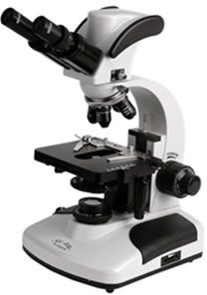
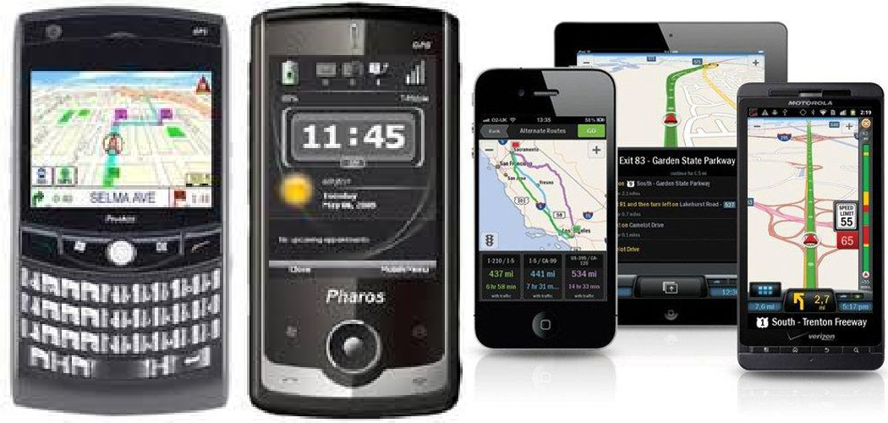
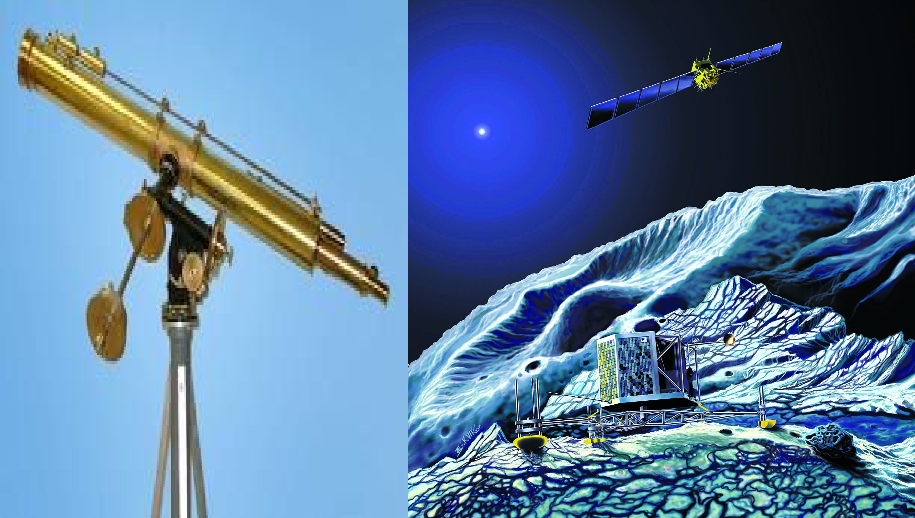
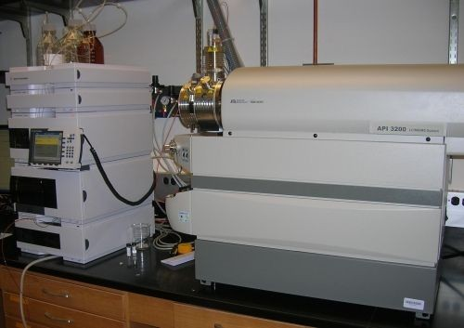
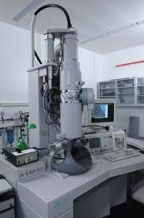
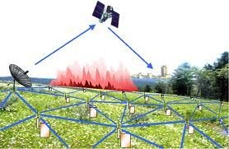
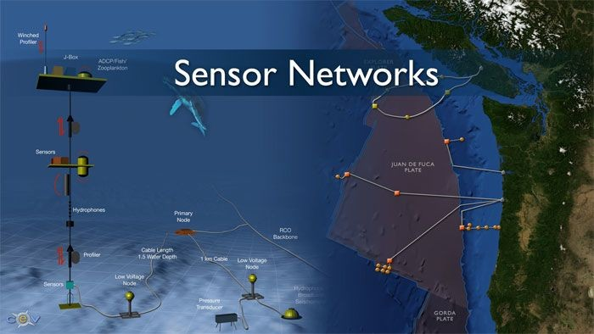
Real-time/Fast Data
Mobile devices
(tracking all objects all the time)
Social media and networks
(all of us are generating data)
Scientific instruments
(collecting all sorts of data)
Sensor technology and networks
(measuring all kinds of data)
The progress and innovation is no longer hindered by the ability to collect data
But, by the ability to manage, analyze, summarize, visualize, and discover knowledge from the collected data in a timely manner and in a scalable fashion
14

Slide 10





Real-Time Analytics/Decision Requirement
Product
Recommendations that are Relevant & Compelling
Learning why Customers Switch to competitors and their offers; in
time to Counter
Influence Behavior
Customer
Friend Invitations to join a
Game or Activity
that expands business
Improving the Marketing Effectiveness of a Promotion while it is still in Play
Preventing Fraud as it is Occurring & preventing more proactively

Slide 11
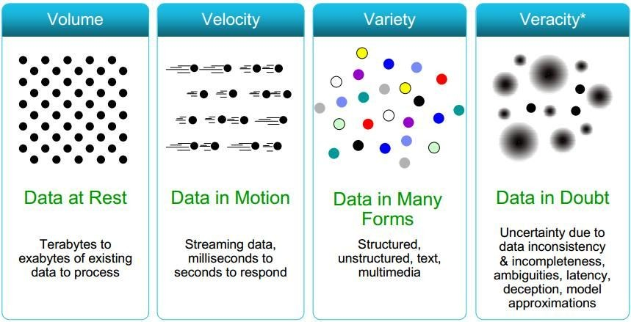
Some Make it 4V’s
16

Slide 12
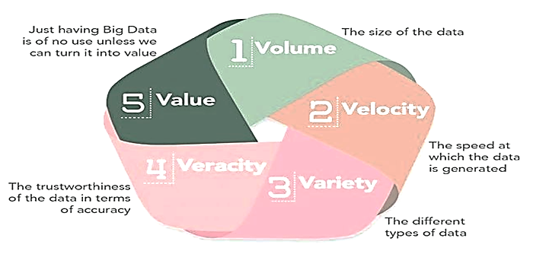
5V’s of Data science

Slide 13


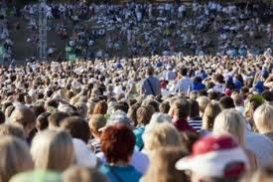





The Model Has Changed…
The Model of Generating/Consuming Data has Changed
Old Model: Few companies are generating data, all others are consuming data
New Model: all of us are generating data, and all of us are consuming data
19

Slide 14

Big data
Big data is high-volume, high-velocity and/or high-variety information assets that demand cost-effective, innovative forms of information processing that enable enhanced insight, decision making, and process automation.

Slide 15

What is Data Science?
Data Science is an interdisciplinary field that focuses on extracting knowledge from data sets which are typically huge in amount.
The field encompasses analysis, preparing data for analysis, and presenting findings to inform high-level decisions in an organization.
As such, it incorporates skills from computer science, mathematics, statics, information visualization, graphic, and business.

Slide 16
3 types of Data
Structured data – Structured data is data whose elements are addressable for effective analysis.
It has been organized into a formatted repository that is typically a database.
It concerns all data which can be stored in database SQL in a table with rows and columns.
They have relational keys and can easily be mapped into pre-designed fields.
Today, those data are most processed in the development and simplest way to manage information. Example: Relational data.

Slide 17
3 types of Data
Semi-Structured data – Semi-structured data is information that does not reside in a relational database but that has some organizational properties that make it easier to analyze.
With some processes, you can store them in the relation database (it could be very hard for some kind of semi-structured data), but Semi-structured exist to ease space. Example: XML data.

Slide 18
3 types of Data
Unstructured data – Unstructured data is a data which is not organized in a predefined manner or does not have a predefined data model, thus it is not a good fit for a mainstream relational database.
So for Unstructured data, there are alternative platforms for storing and managing, it is increasingly prevalent in IT systems and is used by organizations in a variety of business intelligence and analytics applications. Example: Word, PDF, Text, Media logs.

Slide 19
Challenges and considerations for handling different data types.
Handling different data types in data science comes with unique challenges due to the diverse nature of datasets and the need for analytical rigor.
1. Data Cleaning and Preprocessing
Challenge: Raw data often contains missing, inconsistent, or irrelevant data types.
Consideration:
Use techniques like imputation for missing values (mean, median, mode, or ML-based imputation).
Standardize inconsistent formats (e.g., dates or currency units).
Remove or encode outliers appropriately.

Slide 20
2. Mixed Data Types in Datasets
Challenge: Data science workflows frequently involve datasets with mixed data types (e.g., numerical, categorical, textual).
Consideration:
Use appropriate encoding for categorical variables (e.g., one-hot, label encoding).
Convert textual data to numerical representations (e.g., TF-IDF or word embeddings like Word2Vec).
Maintain consistency in numerical data precision (e.g., float64 vs. float32).
3. Handling High Cardinality in Categorical Data
Challenge: High-cardinality features (e.g., unique identifiers or names) can inflate model complexity.
Consideration:
Use dimensionality reduction techniques (e.g., embedding layers in neural networks).
Group categories with low occurrences into an "Other" category.

Slide 21
4. Numerical Data Precision and Scaling
Challenge: Large ranges or differences in scales (e.g., age vs. income) can affect model performance.
Consideration:
Apply normalization (e.g., Min-Max scaling) or standardization (z-scores).
Be cautious of loss of precision in floating-point operations.
5. Text Data
Challenge: Text data is unstructured and requires significant preprocessing.
Consideration:
Preprocess using techniques like stemming, lemmatization, and stopword removal.
Handle multilingual data with language detection and tokenization libraries.
Use advanced NLP methods (e.g., transformers) for contextual understanding.
6. Time Series Data
Challenge: Temporal dependencies and irregular intervals make time series unique.
Consideration:
Convert timestamps to consistent formats and extract features like day, month, year, or lags.
Resample irregular intervals to a uniform frequency.
Use models designed for sequential data (e.g., ARIMA, LSTMs).

Slide 22
7. Image and Multimedia Data
Challenge: Handling large file sizes and extracting meaningful features from unstructured image or video data.
Consideration:
Use pre-trained models (e.g., ResNet, EfficientNet) for feature extraction.
Optimize storage using compressed formats without losing crucial information.
8. Data Type Mismatches
Challenge: Errors arise when data is incorrectly labeled or stored (e.g., numerical data stored as strings).
Consideration:
Use automated tools (e.g., Pandas infer_objects) to identify mismatched types.
Validate and convert data types explicitly (e.g., astype() in Python).
9. Missing Data
Challenge: Missing values in different data types (numerical vs. categorical) require tailored handling.
Consideration:
For numerical data, use mean/median imputation or interpolation.
For categorical data, use mode imputation or "Unknown" labels.

Slide 23
10. Large-Scale Data
Challenge: Datasets with millions of rows or high-dimensional data strain memory and processing power.
Consideration:
Use distributed frameworks like Apache Spark or Dask for big data.
Reduce dimensionality using PCA or feature selection techniques.
11. Bias in Data Types
Challenge: Bias in categorical data (e.g., imbalanced classes) can affect model performance.
Consideration:
Apply oversampling (SMOTE) or undersampling to address class imbalance.
Use balanced accuracy or F1-score instead of simple accuracy for evaluation.
12. Data Visualization
Challenge: Visualizing mixed data types can be non-trivial.
Consideration:
Use specialized plots (e.g., scatter plots for numerical, bar plots for categorical).
Combine data types into summary metrics for easier visualization.

Slide 24
Ethical Considerations in Data Science.
Ethical considerations in data science are critical to ensure responsible and fair use of data, algorithms, and outcomes.
1. Data Privacy
Concern: Collection and use of personal data can infringe on individuals' privacy.
Examples:
Tracking users' online behavior without consent.
Exposing sensitive information through data breaches.
Best Practices:
Implement data anonymization techniques (e.g., pseudonymization, differential privacy).
Use encryption for sensitive data storage and transfer.

Slide 25
2. Bias and Fairness
Concern: Models trained on biased data can perpetuate or exacerbate discrimination.
Examples:
A hiring algorithm discriminates against women due to historical bias in the training data.
Facial recognition systems misclassify certain ethnic groups at higher rates.
Best Practices:
Conduct fairness audits to identify and mitigate bias.
Use diverse and representative datasets for training.
Regularly evaluate models for fairness using metrics like demographic parity or equalized odds.
3. Informed Consent
Concern: Individuals may not be fully aware of how their data is being collected and used.
Examples:
Hidden clauses in terms of service agreements.
Using location data from mobile apps without user consent.
Best Practices:
Clearly communicate data collection purposes.
Obtain explicit consent for data usage, especially for sensitive data.
Provide opt-out options and transparency.

Slide 26
4. Accountability
Concern: Lack of accountability can lead to misuse or harm from data science applications.
Examples:
No clear ownership of errors in a predictive healthcare model.
Deploying automated decision systems without oversight.
Best Practices:
Assign accountability to specific roles or teams.
Maintain audit logs to track decisions made by models.
Ensure human oversight for critical decisions.
5. Transparency and Explainability
Concern: Complex models like deep learning are often "black boxes," making decisions hard to interpret.
Examples:
A credit scoring algorithm denies a loan without explaining why.
Autonomous vehicles make critical decisions that cannot be understood or challenged.
Best Practices:
Use explainable AI techniques (e.g., SHAP, LIME).
Clearly document data sources, model assumptions, and limitations.
Provide end-users with interpretable explanations of outcomes.

Slide 27
6. Data Security
Concern: Inadequate security measures can expose sensitive data to cyberattacks.
Examples:
Ransomware attacks targeting healthcare datasets.
Leaks of personally identifiable information (PII).
Best Practices:
Employ robust cybersecurity measures like multi-factor authentication and firewalls.
Conduct regular security audits and penetration testing.
Limit access to sensitive data on a need-to-know basis.
7. Misuse of Data
Concern: Data science tools and techniques can be exploited for unethical purposes.
Examples:
Deepfake generation for spreading misinformation.
Targeted advertising that manipulates vulnerable populations.
Best Practices:
Define ethical use policies for data and models.
Monitor and restrict usage of tools that can cause harm.
Collaborate with ethics boards to review applications.

Slide 28
8. Environmental Impact
Concern: Large-scale data processing and training of AI models have significant energy costs.
Examples:
Training a large NLP model emitting CO₂ equivalent to multiple flights.
Best Practices:
Optimize algorithms for computational efficiency.
Use cloud services powered by renewable energy.
Explore greener machine learning techniques.
9. Intellectual Property
Concern: Unauthorized use of proprietary datasets or algorithms can lead to legal and ethical issues.
Examples:
Using copyrighted content for training AI without permission.
Best Practices:
Respect copyright and licensing agreements.
Properly cite data sources and algorithms.
Develop proprietary datasets ethically and transparently.

Slide 29
10. Impact on Jobs and Society
Concern: Automation and data-driven systems may displace workers or reinforce societal inequalities.
Examples:
AI replacing customer service roles without a transition plan for affected employees.
Predictive policing algorithms targeting marginalized communities disproportionately.
Best Practices:
Engage with stakeholders to assess societal impacts.
Create transition plans for workers affected by automation.
Use data science to identify and mitigate inequalities.
11. Dual-Use Dilemma
Concern: Technologies developed for positive applications can be repurposed for harm.
Examples:
AI used for medical diagnostics being weaponized in military applications.
Best Practices:
Evaluate potential risks during the development phase.
Restrict access to dual-use technologies.

Slide 30
12. Long-Term Consequences
Concern: Decisions made today might have unforeseen negative consequences in the future.
Examples:
Data retention policies leading to misuse decades later.
Best Practices:
Regularly reassess models and data policies.
Adopt a precautionary principle when deploying high-impact applications.

Slide 31
Data science is the future
One of the reasons for the acceleration of data science in recent years is the enormous volume of data (e.g Big Data) currently available and being generated.
Not only are huge amounts of data being collected about many aspects of the world and our lives, but we concurrently have the rise of inexpensive computing. This has formed the perfect storm in which we have rich data and the tools to analyze it.
Advancing computer memory capacities, more enhanced software, more competent processors, and now, more numerous data scientists with the skills to put this to use and solve questions using the data!
And that’s the big reason why do we need data science in the future.

Slide 32
Data Science vs big data
Data Science | Big data
It is about the collection, processing, analyzing, and utilizing of data in various operations. It is more conceptual. | Big Data is a technique to collect, maintain and process huge information.
It is a field of study just like Computer Science, Applied Statistics, or Applied Mathematics. | It is a technique for tracking and discovering trends in complex data sets.
The goal is to build data-dominant products for a venture. | The goal is to make data more vital and usable i.e. by extracting only important information from the huge data within existing traditional aspects.
Tools mainly used in Data Science include SAS, R, Python, etc | Tools mostly used in Big Data include Hadoop, Spark, Flink, etc.

Slide 33
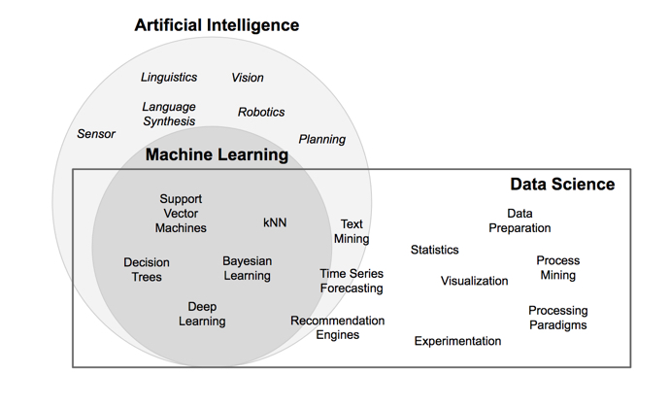

Slide 34
Datafication
Datafication is a process of “taking all aspects of life and turning them into data.”
Examples: Twitter datafies stray thoughts. LinkedIn datafies professional networks.”
Example: “Wal-Mart is able to take data from your past buying patterns, their internal stock information, your mobile phone location data, social media as well as external weather information and analyse all of this in seconds so it can send you a voucher for a BBQ cleaner to your phone– but only if you own a barbeque, the weather is nice and you currently are within a 3 miles radius of a Wal-Mart store that has the BBQ cleaner in stock.”
We are being datafied, or rather our actions are, and when we “like” someone or something online, we are intending to be datafied, or at least we should expect to be. But when we merely browse the Web, we are unintentionally, or at least passively, being datafied through cookies that we might or might not be aware of. And when we walk around in a store, or even on the street, we are being datafied in a completely unintentional way, via sensors, cameras, or Google glasses.

Slide 35
The Data Science Lifecycle
Data Acquisition, Data Entry, Signal Reception, Data Extraction. This stage involves gathering raw structured and unstructured data.
Capture
Analyze
Communicate
Process
Maintain
Data Mining, Clustering/Classification, Data Modeling, Data Summarization. Data scientists take the prepared data and examine its patterns, ranges, and biases to determine how useful it will be in predictive analysis.
Data Warehousing, Data Cleansing, Data Staging, Data Processing, Data Architecture. This stage covers taking the raw data and putting it in a form that can be used.
Data Reporting, Data Visualization, Business Intelligence, Decision Making. In this final step, analysts prepare the analyses in easily readable forms such as charts, graphs, and reports.
Exploratory/Confirmatory, Predictive Analysis, Regression, Text Mining, Qualitative Analysis.

Slide 36
A Data Science Profile
On a daily basis, a data scientist may do the following tasks:
Discover patterns and trends in datasets to get insights.
Create forecasting algorithms and data models.
Improve the quality of data or product offerings by utilising machine learning techniques.
Distribute suggestions to other teams and top management.
In data analysis, use data tools such as R, SAS, Python, or SQL.
Top the field of data science innovations.

Slide 37
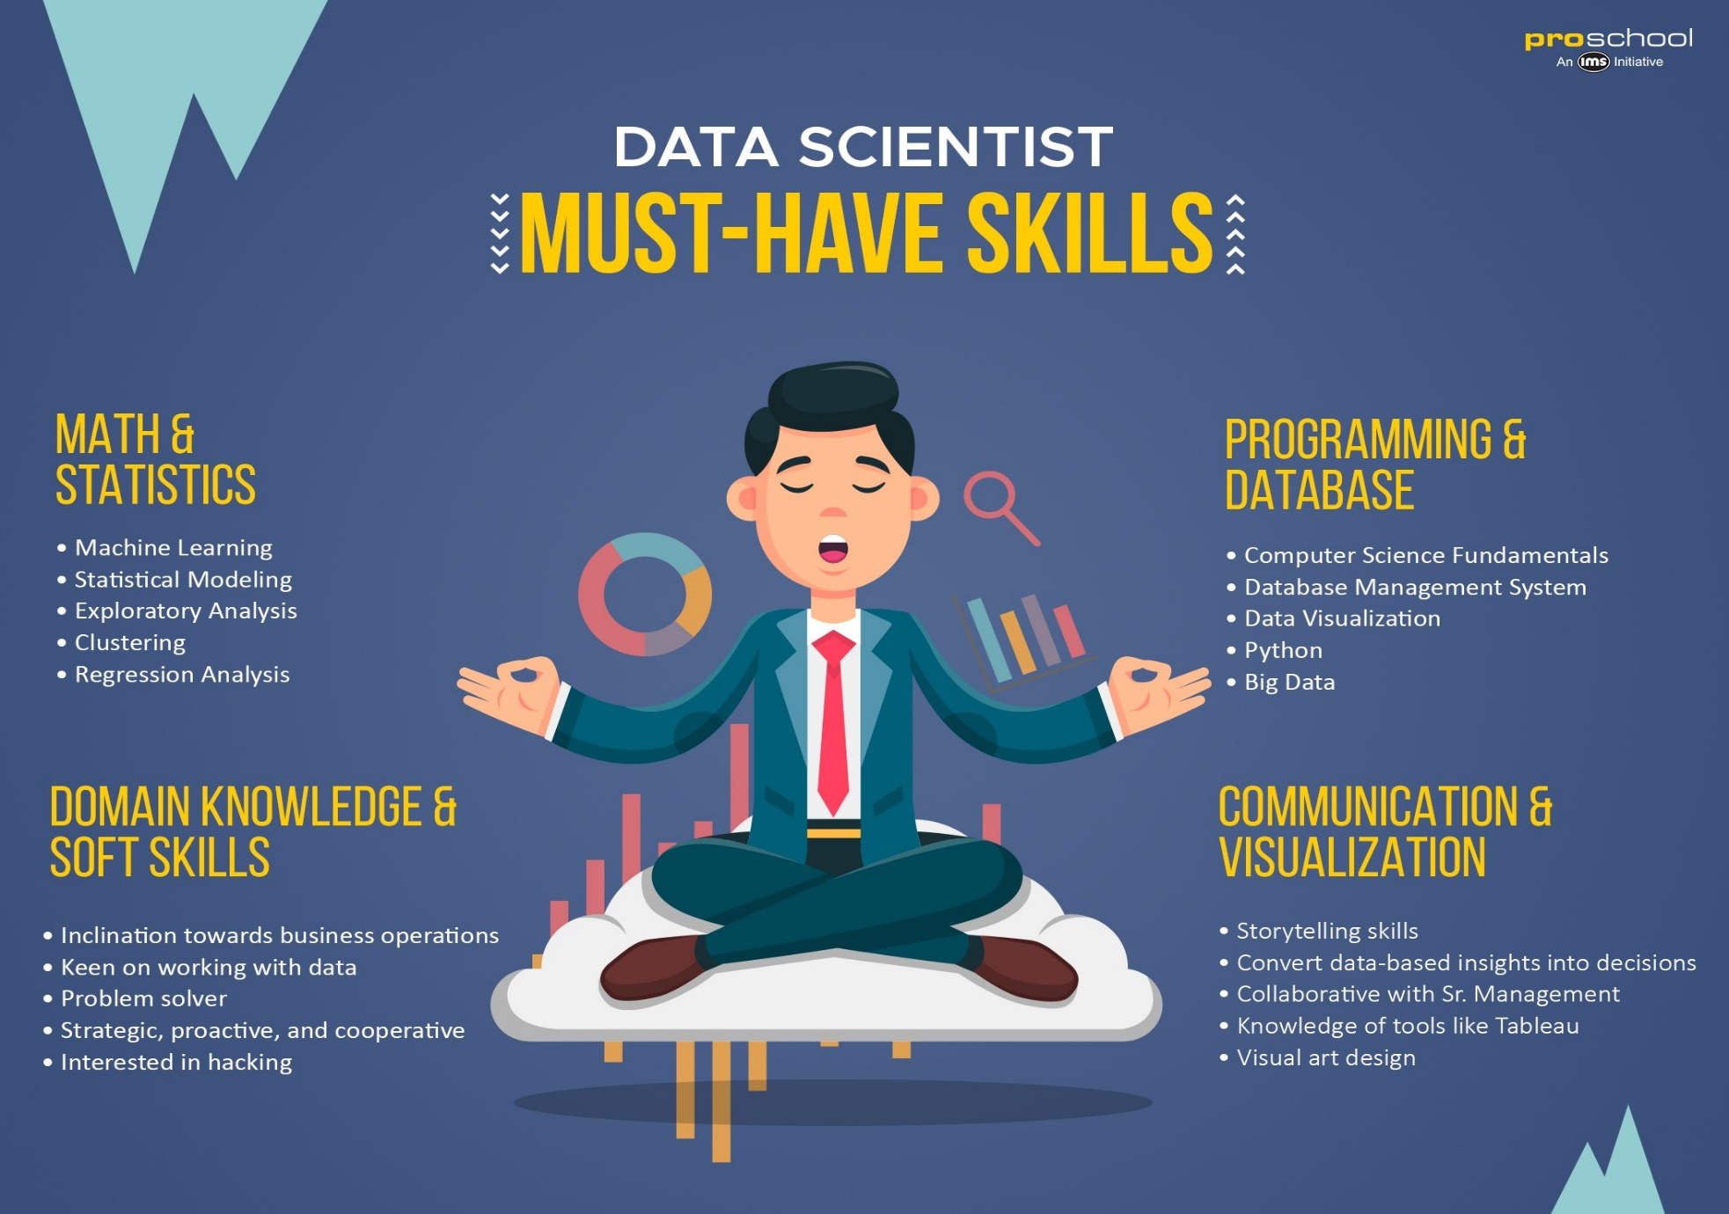

Slide 38
Are data science jobs in demand in India?
The Indian analytics industry is predicted to escalate to USD 98 billion in 2025 and nearly USD 119 billion in 2026. Currently, the demand for data scientists is at an all-time high in India. Analysts have predicted around 11 million job openings in data science by 2026 in India alone.

Slide 39
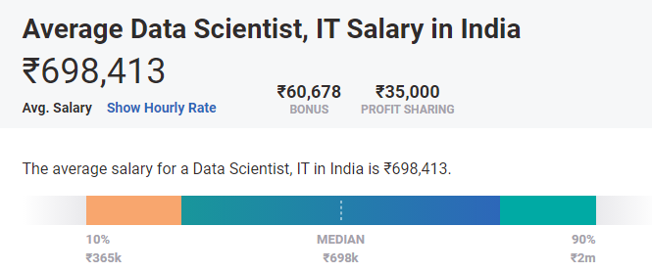
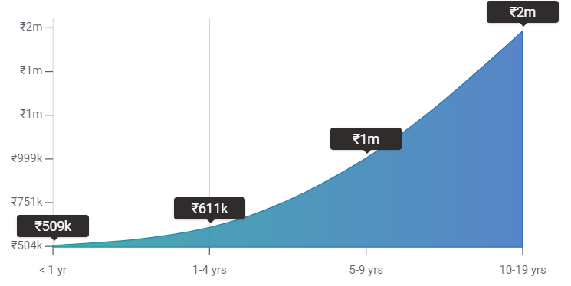
Source: https://www.payscale.com/research/IN/Job=Data_Scientist%2C_IT/Salary

Slide 40
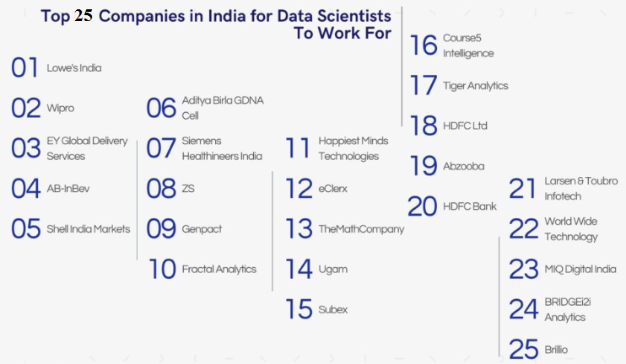
Top Data Scientist Recruiters
Amazon
Deloitte
Fractal Analytics
LinkedIn
MuSigma
Flipkart
IBM
Accenture
Citrix
Myntra
Dexlock
Rudder Analytics

Slide 41
Impact of applying Data Science in business scenario
As a business, your goals are sure to provide better products to the consumers so that they come back.
Data science helps in developing user-centric products using analysis of customer reviews, analyzing current market trends, comparing two products, and finalizing the best products with the ability to attract customers and hold on to them for a longer time.

Slide 42
Impact of applying Data Science in business scenario
1. Reduces Inefficiencies
Inefficiencies often cost businesses up to 30% of their revenue. Data scientists track a range of company-wide metrics – factory production times, delivery expenditure, employee productivity, and more – and pinpoint areas for improvement.
By limiting wasted resources, it’s possible to lower overall costs and boost return-on-investment.
2. Predicts Trends and Customer Behavior
On a practical level, data-based predictions have an array of applications. It’s possible, for example, to determine peak customer shopping times and adjust staff levels accordingly, or to identify early buyer trends and implement appropriate promotional campaigns.

Slide 43
Impact of applying Data Science in business scenario
3. Enables Competitor Research
Data scientists are responsible for understanding and gleaning insights from data about competitors. Effective competitor research helps businesses make competitive pricing decisions, reach new markets, and stay up to date with changes in consumer behavior.
4. Allows Testing of Business Initiatives
Consistent, long-term testing enables companies to drive incremental revenue gains. Data scientists are responsible for conducting extensive tests to guarantee successful marketing campaigns, product launches, employee satisfaction, website optimization, and more.

Slide 44
Impact of applying Data Science in business scenario
5. Develops Market Understanding
Data science enables businesses to consistently reshape their products and services to fit with a shifting marketplace.
Data about customers is available from a variety of sources, and mining information from third-party platforms, like social media, search engines, and purchased datasets, presents a unique challenge.
6. Informs Hiring Decisions
One of the big problems faced by businesses when searching for new employees is the disconnect between prospects that look good on paper and perform well in practice. Data science seeks to bridge this gap by using evidence to improve hiring practices.
By combining and analyzing a variety of data-points about candidates, it’s possible to move towards an ideal ‘company-employee fit’.

Slide 45
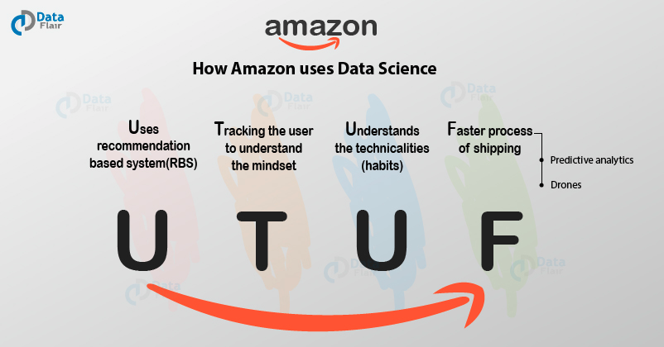

Slide 46
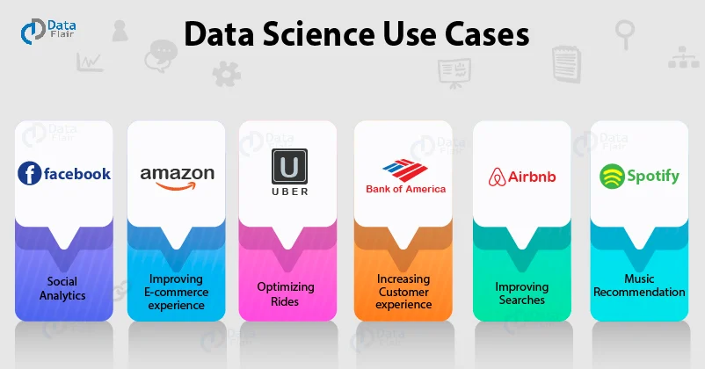
Data science use cases
https://data-flair.training/blogs/data-science-use-cases/

Slide 47
What Data Scientists At Uber Are Doing With Your Data?
Going from one place to another has never been simpler, for all you have to do is open the Uber app, type your destination, and click on “Find Ride.” That’s all. But have you ever wondered what goes on behind the scenes or the complex processes behind that simple click on the app that enables you to travel hassle-free?
While you wait for your cab and forget all about it once you reach your destination, a team of data scientists at Uber works tirelessly to solve existing challenges, provide a better user experience, improve its geo-mapping, and research on driver-less cars. These curious souls use machine learning to not only improve your experience but also make their technologies learn to serve you better in the future.

Slide 48
Case study-uber
Intelligent Ride Management Every ride you book gives the AI team at Uber an enormous amount of information about you — right from your preferred pick-up point to your most frequent destinations. Uber records your behavior, preferences, interests, and even your phone’s battery level. This helps them determine demand, the resources to allocate, and set fares to maximize profit. While sometimes the team would use data month to month, a larger set is required for a seasonal understanding of certain tasks that may go back years. A data expert’s idea is to collect data smartly and clean it to find relevance in it.
the AI team at Uber extracts in terms of information. They collect even more data from the drivers, irrespective of whether they are carrying passengers or not. Drivers’ speed and acceleration, their location, data on whether they work for a competitor (like Ola) is all possible to retrieve. The AI team then draws inferences from understanding traffic patterns, ETA, journey times, and surge pricing.

Slide 49
Case study-uber
Pricing Longer or shorter journey times give them the advantage of real-time pricing (remember the surge price that you see?). Data Scientists use predictive modelling in real time to estimate demand and execute informed pricing. Uber has even applied for a patent on this method of calculating “surge pricing”. Hotel chains and airlines also use dynamic pricing, in the same way, to meet demand and adjust prices, especially during public holidays, weekends, and popular events.
The supply and demand analysis algorithms developed by the AI team capture and monitor traffic conditions and journey duration in real time. As the demand for cabs changes, the pricing is adjusted in real-time. As the traffic conditions change, so do the journey ETAs. This is convenient for drivers as they can decide to proactively hit areas slated for higher demand and stay low when the demand drops.

Slide 50
Case study-uber
Mapping Data scientists build models using several map services like Google Maps. But a lot of information on those maps is either irrelevant or inaccurate (at least not accurate to the point they would like it to be). For example, if you visit the Ambience Mall in Gurgaon, a map would show you and the Uber driver that you have arrived at your destination while you could be almost 500 meters away from the gate you want to enter from. Data from a million trips enabled the team to offer pick/drop services to specific gates that may seem so basic to an end-user. More information that they retrieve is translating into enhanced mapping that tackles existing challenges and helps move to the next level.

Slide 51
Case study-uber
Driver-Less Cars The Uber AI Labs at Pittsburgh is running experiments with autonomous cars, and it won’t be long before driverless cars become humdrum. By improving their mapping system with deep learning (meaning machines learn better with more exposure similar to how humans learn), scientists are taking us a tad bit faster into the future. The best part is that the machines are not only learning just once through algorithms but throughout the process of testing and implementation. As more trips are taken, as more models are built using AI, the machines are getting smarter about handling unprecedented scenarios.

